Slide 1
Hermod
A platform for instant and seamless customer interaction.
Russell Weas, Jonathan Pence, Do Thien An Duong, Simon Jeon

Slide 2
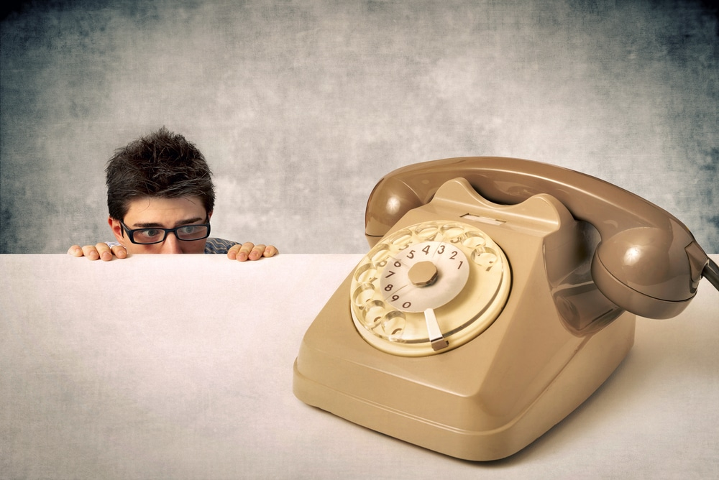

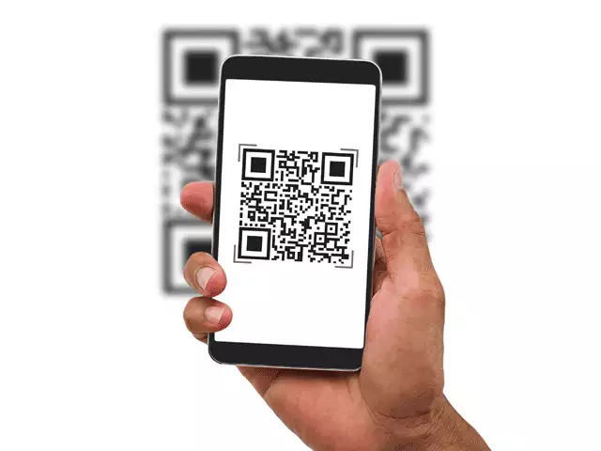

General Motivation
Users:
Companies/businesses
Customers
Notes:
Our project encompasses both the companies and the customers as our users where both end of the users can have an advantage in providing and receiving their services. This project allows for companies and their customers to interact with one another without having to depend on a single line of communication via phone number. For example, usually one would walk into a restroom needing a toilet paper and would have to call a phone number on the stall door to call and request for their service. This requires the customer to awkwardly call and tell the administrator where they are and what services they would be needing. To further remove the unnecessary awkward and inefficient time, the customer could possibly scan a QR code leading directly to a web page designated for their specific location and they could just type in their services or press on a button to notify the staff. Additionally, having a system where the user can contact a staff without having to give information on how to better serve them gives ease and efficiency for both the companies and the customers. There are multiple usages for this. You could use them in hotels or even airbnbs where the customer can alert the staff/owners of their complaints without having to call and notify their locations.
This idea can be “useless” for people who do not mind calling for a staff member for assistance, however, this project focuses mainly on those who have difficulty communicating via phone. Those who have phone anxiety/telephobia can be better assisted by providing a new way of communication rather than a single line of communication via telephone.

Slide 3
Admin/Editor User - Companies/businesses
Company Account
Where
Receive Notices
contains
What
Post QR codes for customers
Who (optional)
Generate QR Code
Manage Employees and Webpage
Assign Task
Provide Service
Notes:
Labor shortage
Large businesses have adopted QR codes - small ones haven’t

Slide 4
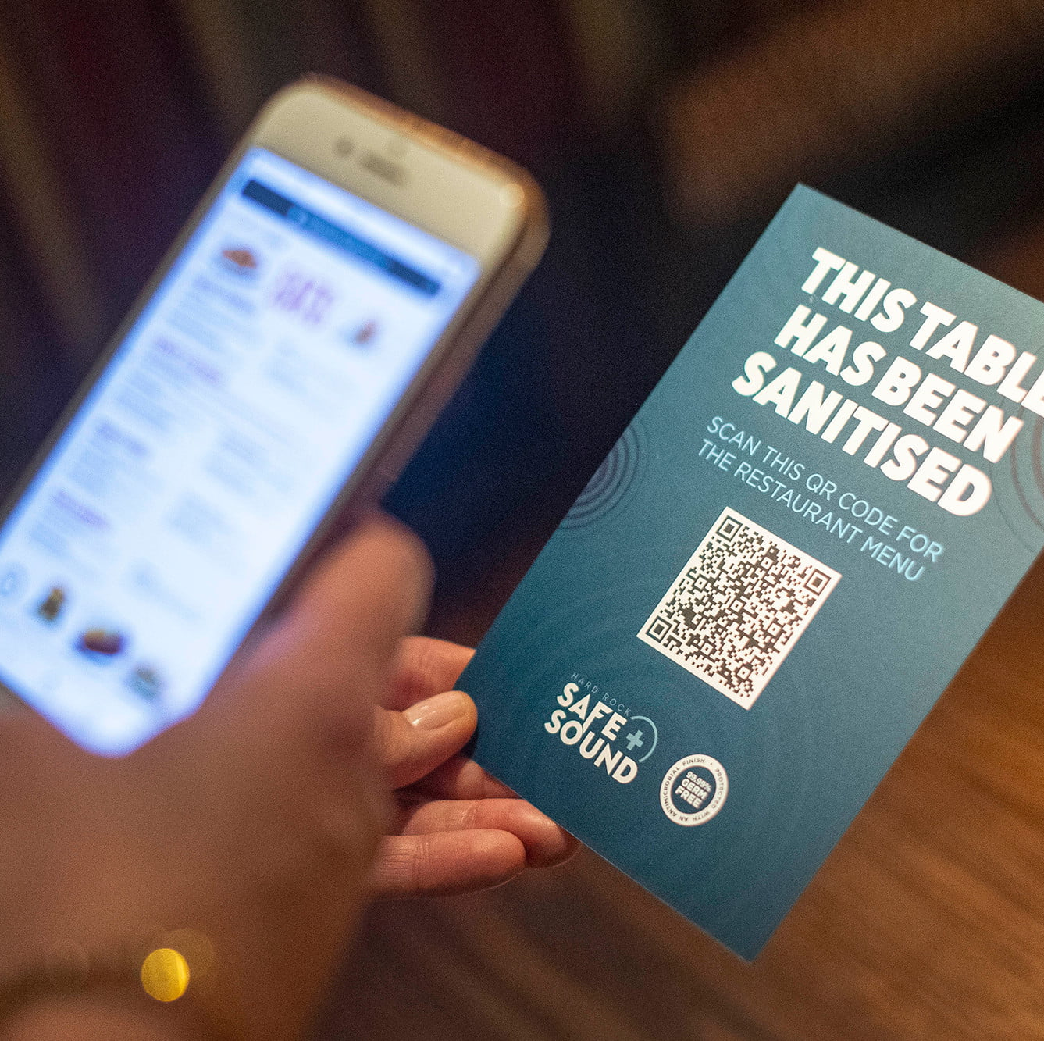
General User - Customers
2013 - QR Code bubble
2017 - iOS added a QR code scanner
2020 - COVID-19 accelerates QR code adoption [1]
US market catching up to China
Customers now expect fast and easy digital interactions
Notes:
QR Codes had a “bubble” in 2013 - it was overused and overly difficult to use
In 2017, iOS added a QR code scanner into the Camera application
In 2020, the COVID-19 pandemic accelerated the widespread adoption of QR codes in daily life [1]
US is catching up to adoption rates in other countries - for example, Chinese tech giants Tencent and Alibaba based their growth around cashless technologies using QR codes
Customers have grown to expect simple and rapid tools to digitally interact with businesses

Slide 5
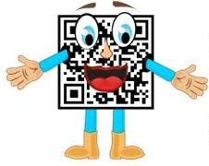
Core Features - Customer QR Form
Associated with company grounds/processes
Automatically notifies companies
Ability to collect feedback
Customizable appearance
Notes:
We have two basic sets of core features. The first set will be the QR codes and their associated forms, and the second set will be the administrative interface provided to company clients.
As aforementioned, the QR code feature is what is offered to companies. The two most important features are the associations with company grounds and processes and the fact that responses are automatically sent to the company whenever a customer scans a code.
To elaborate on these, the association with grounds and processes implies that specific QR codes will be tied to a specific location or business process. The benefit of this is such that companies will automatically be able to sort and parse customer feedback based on which QR code is scanned; for example, a QR code scanned in a bathroom stall could automatically inform a company employee about a dysfunctional toilet!
An extension to these two basic functionalities is the addition of forms to the QR codes. Instead of just configuring an automatic response, companies can opt to associate forms so that genuine customer feedback can be collected and reported. The benefit of context-sensitive QR codes remains and the company is able to collect detailed information from its customers.
Finally, companies will have the option to customize the appearance of their QR codes. This will include aesthetic options such as color or framing, but can also include annotations so that customers will be easily able to tell what a posted QR code does.

Slide 6

Core Features - Corporate Admin Panel
Login authentication
Company profile management
QR code management
Generate, browse, manage lifetimes
Annotate
Form configuration
Response behavior configuration
Employee profile
Manage contact information
Notes:
The second feature set is the administrative interface provided to company clients. Here, companies will be able to manage their profiles, their QR codes, and their employee profiles.
Login authentication will be provided; we won’t split hairs on this too much since it’s a fairly stock feature.
Company accounts will have several data associated with it, such as business names, locations, payment methods, etc. These will all be configurable. Besides these, company accounts will control two sets of data: QR codes and employee profiles.
Companies will be able to manage the QR codes under their control. This will include the basics such as generating new QR codes, browsing existing QR codes, and deleting deprecated QR codes. The more complex feature of QR code management will be the ability to annotate QR codes: companies will be able to describe what the QR code is associated with, such as a specific room number or a specific business process. Companies will be able to enable and configure the forms associated with QR codes with an interface akin to one might see with Google forms. Finally, companies will be able to configure the types of responses generated by QR code scans; for example, a company may specify that scanning QR code number one will immediately send a call to an employee’s phone, while QR code number two could send an e-mail to a company address fifteen minutes after the code is scanned.
Finally, we provide employee profiles for the sake of convenience. This essentially amounts to name, number, and e-mail address management; instead of having to manually keep track of all those different data points, companies can set-up employee profiles to easily keep track of the contact information they use as end-points for QR code responses.

Slide 7








Technical Implementation
Frontend - React, TailwindCSS
Backend - Rust, PostgresDB
API’s - Twilio, Postmark, Stripe
Hosting - Docker containers on Digital Ocean
Notes:
rw

Slide 8





Related Apps
Qualtrics
Google Surveys/Forms
SurveyMonkey
SignUpGenius
Tencent/Alibaba
Notes:
Our solution is better - it allows for context-based feedback (i.e. there’s a problem in stall 9 in the men’s bathroom in Gorgas floor 2) and automated responses (the employee currently on-call receives a text message 15 minutes later with the relevant information)

Slide 9

Challenges
Authentication/authorization for corporate clients
Working with new APIs
UX Design
Notes:
Authentication / authorization - companies have complex organizational structure - i.e. Corporate purchases Hermod license, but employees at various branches have to be granted Hermod accounts
Accommodate different complex organizational structure. For example, granting permissions to employees at various branches
Working with new APIs - Integrate and debug the APIs.
UX Design - Designing an intuitive and minimal interface in order to reduce resistance for the users to provide feedback.

Slide 10
Questions?

Slide 11
Sources
[1] “It took a pandemic to make QR codes relevant.” https://blog.avast.com/qr-codes-in-the-covid-19-pandemic-avast

